Slide 1
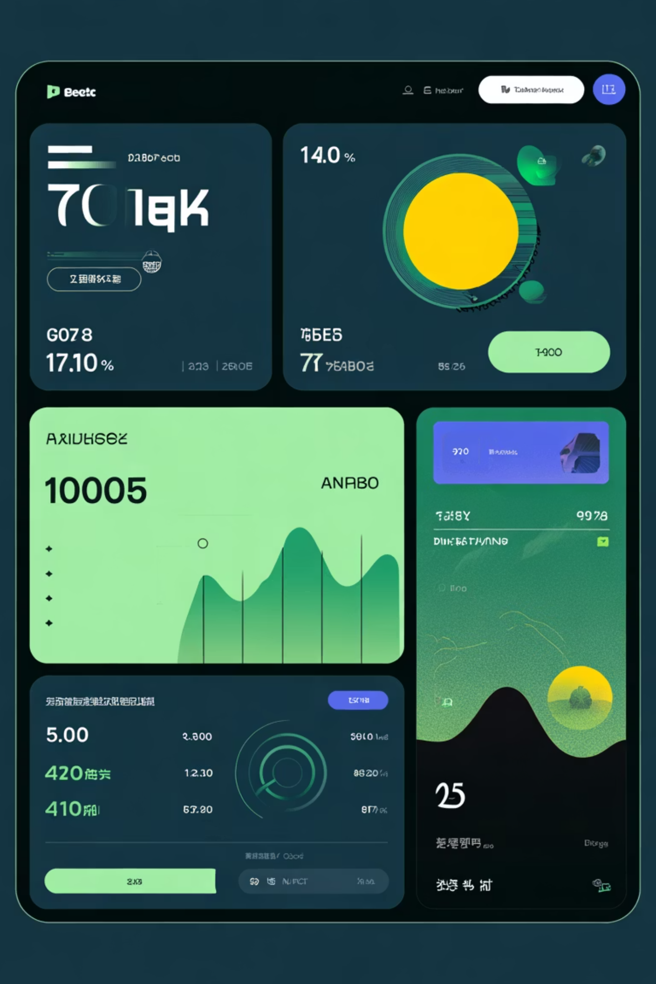
FINANCIAL ANALYTICS
Power BI Banking Dashboard: Loan and Deposit Analysis

Slide 2

Project Overview: Unlocking Insights from Banking Data
Core Dataset
Loan Analysis
This dashboard leverages a comprehensive banking dataset to derive actionable financial intelligence.
We provide in-depth analysis of loan portfolio performance, distribution, and key risk factors.
Deposit Analysis
Overall Summary
Insights into customer deposit behavior, segmentation, and trends across various account types.
A concise summary of the entire dataset, highlighting crucial KPIs and overall financial health metrics.

Slide 3
Key Performance Indicators (KPIs)
188
$18.26K
$135
Total Clients
Total Engagement Account Value
Total CC Account Value
The total number of active clients included in the analysis of the banking portfolio.
The cumulative outstanding balance across all active Credit Card (CC) accounts.
Aggregated value across all highly engaged customer accounts (measured in thousands).
These initial metrics provide a snapshot of the bank's client base and account engagement levels.

Slide 4

Core Financial Goals and Targets
Total Loan Portfolio
$139.9M
The total value of all outstanding loans managed by the institution.
Total Customer Deposits
$111.49M
Total liabilities in the form of deposits held by clients across all account types.
Total Fees Generated
$5.17M
Cumulative income derived from various service charges and transaction fees.

Slide 5

Portfolio Distribution: Key Financial Metrics
A breakdown of the institution's key financial balances, indicating portfolio weight across different areas.
$55.5M
$60.18M
Bank Loan
Bank Deposit
Current exposure in the standard consumer and commercial loan segments.
Total funds held in standard checking and savings deposit accounts.
$83.52M
Business Lending
Capital allocated specifically to small to mid-sized enterprise (SME) lending.

Slide 6


Account Breakdown: Savings and Foreign Currency
Savings Account (in Millions)
Foreign Currency Amount (in millions)
19.85
2.71
The total value held in interest-bearing savings accounts, a key measure of stable capital.
The total amount of funds held in non-local currencies, reflecting international activity.

Slide 7

INTERNATIONAL PORTFOLIO FOCUS
$2.71 M
Foreign Currency Holdings
This significant amount highlights the bank's exposure and opportunity in international markets, managing diverse currency accounts for global clients.

Slide 8

Loan Portfolio Segmentation: Analysis by Income Band
What We Observe:
Loan distribution is disproportionate across income segments. The Mid Income band holds the highest percentage of the bank loan portfolio, while the High Income band shows the lowest loan uptake.
This suggests a strong engagement with middle-market clients, which may warrant strategic review for risk profile or an opportunity to expand offerings to the High Income bracket.

Slide 9
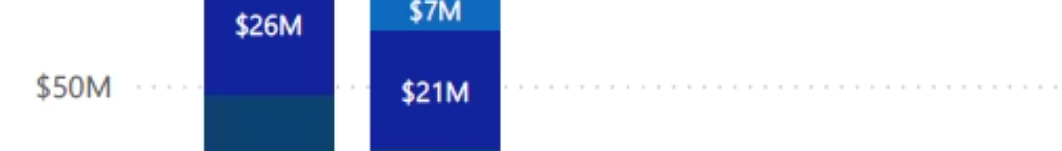
Geographic Feature Distribution
Key Observations on Features by Region
European Dominance
Strong Asian Presence
The highest concentration of product features and offerings are localized in European countries, indicating market focus.
Asian countries follow Europe in terms of feature availability, reflecting a growing strategic importance in this region.
Lowest in Australia
Limited African Scope
The lowest number of features are currently found in Australian countries, pointing to potential areas for future expansion.
Feature availability in African countries is minimal, presenting a significant underserved market opportunity.

Slide 10

Geographic Loan Portfolio: Analysis by Nationality
What We Observe:
Highest Loan Concentration
Lowest Loan Concentration
The highest volume of bank loans is concentrated among clients of European nationalities, aligning with the dominant feature distribution.
Conversely, clients from Australian countries show the lowest engagement in the bank loan portfolio.

